Slide 1
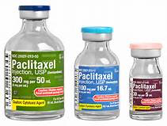
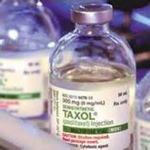
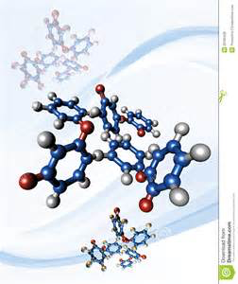
D7 Taxol
Essential idea
Chiral auxiliaries allow the production of individual enantiomers of chiral molecules.

Slide 2
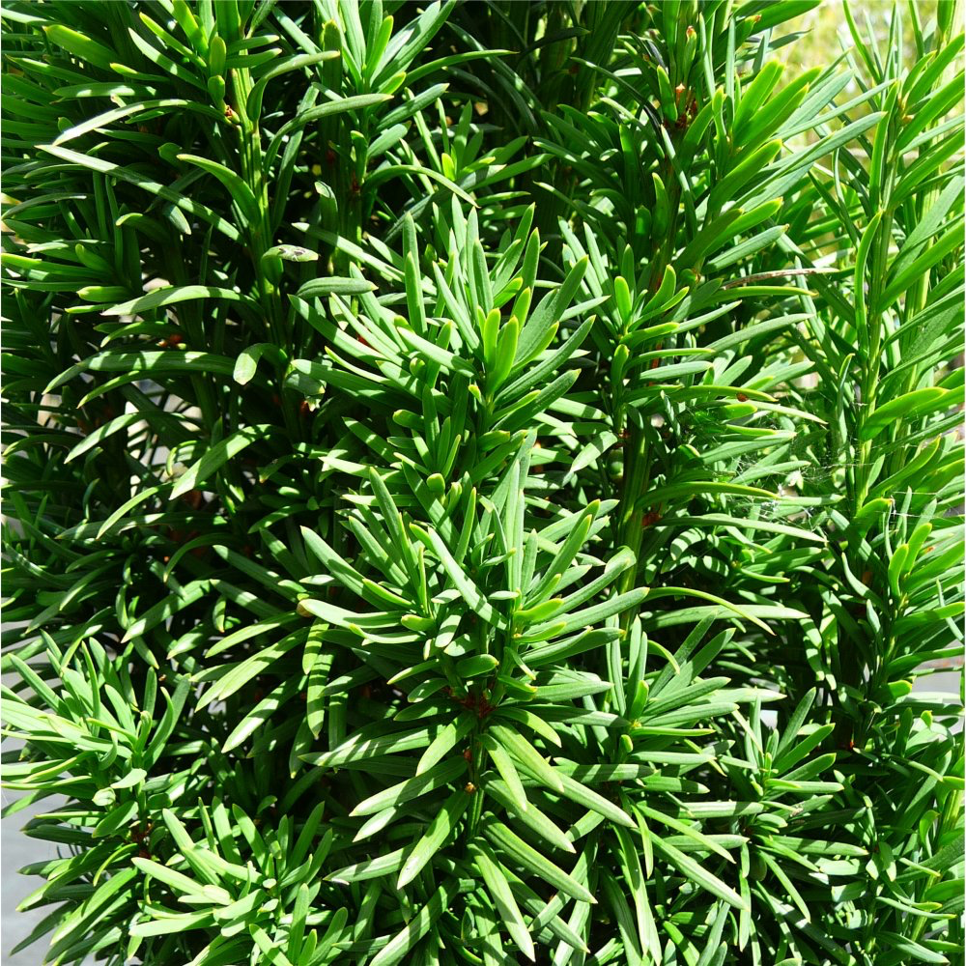
Taxol or paclitaxel
Common anti-cancer drug: breast, ovarian
Chemotherapeutic drug i.e. a chemical
used to treat and control a disease
such as cancer (chemotherapy)
First extracted from the bark of yew trees.
Isolation of taxol from natural sources was very wasteful as it used a lot of bark of trees that were a threatened and were an old species.
A semi-synthetic method was developed that uses a natural precursor (hence semi-synthetic) from the leaves of different but more common and faster-growing yew trees.
Natural precursor is 10-deacetylbaccatin – DAB.
Process involves many steps, different solvents and low yield – not very sustainable!

Slide 3
Issues with chirality in drugs (1)
Molecules of most semi-synthetic or synthetic drugs have chirality (they have an asymmetrical carbon) and have 2 enantiomers.
In nature only 1 enantiomer is formed.
During the synthesis of a chiral semi-synthetic or synthetic drug the other enantiomer will also be produced;
both enantiomers are formed yielding a racemate or racemic mixture (a mixture in which both enantiomers are equimolar).
Taxol is such an enantiomer that is obtained during its synthesis from the natural precursor.

Slide 4
Taxol: identify the chiral carbons (11) – very chiral/many enantiomers - diastereomer

Slide 5
Issues with chirality in drugs (2)
Both enantiomers have the same chemical properties but..
React differently with other chiral compounds such as many enzymes.
Have different physiological effects; some of which will be intended whilst other effects could be harmful.
The physiological effect of each enantiomer needs to be tested. Each enantiomer needs to be treated as a different chemical.
Usually only one of the enantiomers has the desired therapeutic effect and, after synthesis of the drug, this enantiomer needs to be isolated from the racemic mixture. However, this is a wasteful process.
Occasionally both enantiomers have the desired effect and the drug can be administered as a racemic mixture.

Slide 6
Only 1 enantiomer is active

Slide 7
Using chiral auxiliaries in asymmetric synthesis
Direct synthesis of the desired enantiomer by preventing the synthesis of the other enantiomer by using a chiral auxiliary.
A chiral auxiliary (optically active) is used to convert a non-chiral reacting molecule into just one enantiomer i.e. the enantiomer with the desired pharmaceutical effect.
It does this by attaching itself temporarily to the non-chiral reactant molecule to create stereochemical conditions necessary to force the reaction to follow a certain path i.e. the path that will yield the desired enantiomer and not the other enantiomer.

Slide 8
Using chiral auxiliaries in asymmetric synthesis
Once the new desired molecule has been formed, the auxiliary is removed and recycled.
Asymmetric synthesis = the direct synthesis of a single enantiomer. To achieve this the reaction or synthesis has to be stereospecific and the chiral auxiliary achieves this.
In the case of Taxol this technique is used to obtain the desired configuration in its side chains where most of the chiral carbons are.

Slide 9
Action of chiral auxiliary

Slide 10
Explain D7.U3
A chiral auxiliary is an optically active substance that is temporarily incorporated into an organic synthesis so that it can be carried out asymmetrically with the selective formation of a single enantiomer
temporarily incorporated = auxiliary is removed at the end
organic synthesis= making of an organic compound
Asymmetrically = only 1 enantiomer produced
selective formation = only enantiomer

Slide 11
Action of taxol
Taxol is an inhibitor that is effective against solid tumour cancers such as lung, ovarian and breast cancer .
It interferes with the cell division of the cancer cells in the tumor and can therefore stop its growth.
Taxol does this by bonding covalently with a protein called tubulin (taxol’s target) that makes up cellular structures called microtubules.
The binding with the tubulin gives the microtubules stability preventing them from being broken down which is an essential step in the mitosis process and stops any cell division in the tumor.

Slide 12
Green chemistry and taxol
Isolation of taxol from yew trees was very wasteful; used a lot of bark of a species that were threatened, old and took a long time to grow; the removal of the bark also killed the trees.
A semi-synthetic method which had a more ‘green chemistry’ approach was developed that used a natural precursor, 10-deacetylbaccatin (10-DAB) from leaves from different but more common and faster-growing yew trees which was a much more renewable resource. However, process still uses many solvents and has a low yield.
Another method that has been developed involves using fungi that produce taxol in fermentation processes; this does not needs to use any solvents or reagents at all.

Slide 13
Polarimeter
See notes topic 20 on how a polarimeter works.
Polarimeter is used to detect chirality
Can also be used to determine the purity of a taxol sample (identify extent of presence of other enantiomer or diastereomers) as the number of degrees pure Taxol rotates the plane polarized light is known. The angle of rotation measured can be used to determine the percentage purity of the Taxol synthesized.

