Slide 1
pH regulation in stomach
Essential idea
Excess stomach acid is a common problem that can be alleviated by compounds that increase the stomach pH by neutralizing (1) or reducing its secretion (2).

Slide 2
pH regulation in stomach
What pH?
Why?
Where does it come from?
What is the problem?

Slide 3
Acid in stomach
The acid in the stomach is needed to:
Kill any bacteria that were ingested with the food.
Provide the optimum pH environment (between pH 1.0 and 2.0) for the digestive enzymes that act in the stomach (different parts of the digestive tract needs a different pH environment)

Slide 4
Excess acid in stomach
Dyspepsia = conditions that cause pain and discomfort in the upper digestive tract such as the stomach e.g. heartburn and indigestion.
Acid indigestion = discomfort/pain in stomach.
Heartburn = acid from the stomach rising into oesophagus- reflux- that causes inflammation in the oesophagus.
Both are conditions that arise when excess hydrochloric acid is produced by parietal cells in the gastric glands in the walls of the stomach making the gastric juice too acidic as it can have a pH of less than 1.
Ulceration: damage to the stomach wall

Slide 5
Solution
Dyspepsia can be prevented either by:
Regulate pH by reducing the effect of excess acid after it has been released in the stomach by using medicines called antacids to neutralize some of the excess acid.
Preventing the production of the excess acid by using medicines called H₂ –receptor antagonists or proton pump inhibitors.

Slide 6
Action of antacids
Antacids are usually weak bases that are used to neutralize excess hydrochloric acid in the stomach so the pH level returns to the desired level i.e. pH 1.0 to 2.0.
Al(OH)₃ (s) Mg(OH)₂ (s) NaHCO₃(s) Na₂CO₃ (s) MgCO₃(s) and Al(OH)₂NaCO₃(s) are commonly used as active ingredients in such antacids as they are weak bases.

Slide 7
Action of antacids
Antacids containing Al³⁺ are the most effective antacids as they have 3 hydroxide/base ions per formula unit and can therefore neutralize three times as many H⁺ than for instance sodium hydrogen carbonate.
Sodium hydroxide or potassium hydroxide are not used as antacids because they are strong alkalis and are too corrosive to the body tissue.

Slide 8
Antacid equations
Write balanced symbol equations of the reaction with HCl (aq) for all the listed antacids:
Al(OH)₃ (s)
Mg(OH)₂ (s)
NaHCO₃(s)
Na₂CO₃ (s)
MgCO₃(s)
Al(OH)₂NaCO₃ (s)

Slide 9
Balanced equations - answers
Al(OH)₃ (s) + 3HCl (aq) → AlCl₃ (aq) + 3H₂O (l)
Mg(OH)₂ (s) + 2HCl (aq) → MgCl₂ (aq) + 2H₂O (l)
NaHCO₃(s) + HCl (aq) → NaCl (aq) + H₂O (l) + CO₂(g)
Na₂CO₃ (s) + 2HCl (aq) → 2NaCl (aq) + H₂O (l) + CO₂(g)
MgCO₃(s) + 2HCl (aq) → MgCl₂ (aq) + H₂O (l) + CO₂(g)
Al(OH)₂NaCO₃(s) + 4HCl (aq) → AlCl₃ (aq) + NaCl (aq) + 3H₂O (l) + CO₂(g)
Ionic equations:
OH⁻ (aq) + H+ (aq) → H₂O (l)
CO₃²⁻ (aq) + 2H⁺ (aq) → H₂O (l) + CO₂(g)
HCO₃ + H⁺ → H₂O (l) + CO₂(g)

Slide 10
Alginates
Some antacids contain compounds called ‘alginates’ which prevent heartburn by
producing a neutralizing layer on top of
stomach contents and
preventing acid in the stomach from rising into the oesophagus (refluxing) and causing heartburn (inflammation and pain).

Slide 11
Anti-foaming agents
Antacids that use carbonates also contain anti-foaming agents such as dimethicone which reduce the bloating of the stomach as a result of the carbon dioxide production.

Slide 12
Calculations of the pH of a buffer
Buffering systems exists in the human body to regulate the pH in various environments including cells.
What are buffering systems and how do they do it?
Henderson-Hasselbalch equation + excercises

Slide 13
Buffer calculation

Slide 14
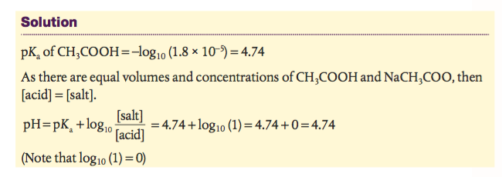
Buffer calculation answer

Slide 15
Reducing the secretion of the acid (1)
H₂-receptor antagonists
Production of HCl involves hormones (such as histamine) that interact with H₂-receptors in the parietal cells in the gastric glands and this stimulates the production of HCl that is released in the lumen of the stomach.
Drugs called H₂-receptor antagonists, such as ranitidine (Zantac), can be used to prevent the histamine from interacting with the H₂-receptor and therefore inhibiting acid production. As the drug has a similar structure to the histamine, it competes with histamine to interact and bind with the H₂-receptors preventing the histamine from doing so

Slide 16
H₂-receptor antagonists

Slide 17
Reducing the secretion of the acid (2)
Proton pump inhibitors
After the acid has been produced its secretion into the stomach involves a transfer of H⁺ ions (protons) into the lumen of the stomach and this is balanced out by a movement of K⁺ in the opposite direction to balance the charges in the lumen.
The H⁺ ions are transferred or pumped into the lumen by the parietal cells; these cells are therefore referred to as proton pumps.
This proton pumping process requires energy as it goes against concentration gradient) that is provided by the hydrolysis of ATP and this requires an enzyme referred to as H+/K⁺ ATPase or a gastric proton pump.
Compounds such omeprazole (Prilosec) and esomeprazole (Nexium) inhibit the action of the enzyme and therefore the release of the acid into the stomach.

Slide 18
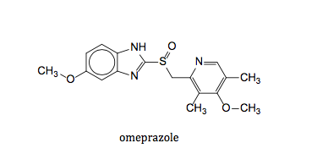
Proton pump inhibitors

Slide 19
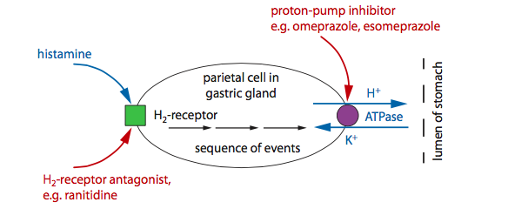
Reducing the secretion of the acid (3)

Slide 20
In summary
Symptoms of acid indigestion and heartburn can be relieved by increasing the pH of the stomach by either:
Reducing the effect of the excess acid after it has been released in the stomach by using antacids to neutralize some of the excess acid. Antacids have an immediate effect but only last for a short-term.
Preventing the production of the excess acid in the first place by using H₂ –receptor antagonists or proton pump inhibitors. Both the H₂ –receptor antagonists and proton pump inhibitors take a longer time to provide relief but have a longer term effect; they can also be used to treat ulcers.

Slide 21
Active metabolite
An active metabolite is an active form of a drug that has been administered in an inactive form because of a number of reasons. The inactive form is then metabolized by the body into its active form (bioactivated) that has a greater therapeutic effect than the inactive form.
Possible reasons for using an inactive form include:
Has greater bioavailability because it is more soluble or is absorbed faster.
Easier to administer.
More selective in its interaction with healthy cells.
Has fewer side effects linked to the administration.
Can be stored longer.
Can withstand different storage conditions.

Slide 22
Example of an active metabolite
An example where active metabolites are used are the proton pump inhibitors esomeprazole and omeprazole.
They are administered in their inactive form as it allows the drugs to, once in the body, easily cross the cell membranes of the parietal cells (giving the drug a higher bioavailability).
In the inactive form they cannot interact with the gastric proton pump.
However, the hydrochloric acid in the parietal cells causes both the esomeprazole and omeprazole to change from its inactive into an active form that can interact with the gastric proton pump and inhibit its action.

