Slide 1
Dissociation of ozone and oxygen
Calculation of wavelength of one photon to dissociate O₂ when the bond enthalpy is 498 kJ mol⁻¹.
Calculation of bond enthalpy in kJ mol⁻¹ for ozone when a wavelength of 300 nm is needed.

Slide 2
Answer question 1
Calculation of wavelength of one photon to dissociate O₂ when the bond enthalpy is 498 kJ mol⁻¹
E of one photon is
498 000 J mol⁻¹ /6.02 x 10²³ mol⁻¹ = 8.27 x 10⁻¹⁹ J
E = hf and f = c / λ
∴E = h c / λ
λ = h c / E
= (6.63 x 10⁻³⁴ J s x 3.00 x 10⁸ m s⁻¹ ) /8.27 x 10⁻¹⁹ J
= 2.41 x 10⁻⁷ m = 241 nm

Slide 3
Answer question 2
Calculation of bond enthalpy in kJ mol⁻¹ for ozone when a wavelength of 300 nm is needed
E = h c / λ.
= (6.63 x 10⁻³⁴ J s x 3.00 x 10⁸ m s⁻¹ ) /300 x 10⁻⁹ m
= 6.63 x 10⁻¹⁹ J (one photon/one bond)
For 1 mole of bonds:
6.63 x 10⁻¹⁹ J x 6.02 x 10²³ mol⁻¹
= 399126 J mol ⁻¹ = 399 kJ mol⁻¹

Slide 4
Photodissociation
photodissociation of O₃
photodissociation of O₂
equation | O₃ + uv ⎯→ O₂ + O•
UV wavelength, λ, nm | shorter than 330
frequency, f, s⁻¹ | f = c / λ = 3.00 x 10⁸ m s⁻¹ /330 x 10⁻⁹ m = 9.10 x 10¹⁴ s⁻¹
bond enthalpy, kJ mol⁻¹ | 363
covalent bond types | one σ+ 2 delocalized π electrons between a double and single bond (bond order 1.5)
equation | O₂ + uv ⎯→ O• + O•
UV wavelength, λ, nm | (shorter than) 242
frequency, f, s⁻¹ (higher energy radiation) | f = c / λ = 3.00 x 10⁸ m s⁻¹ /242 x 10⁻⁹ m = 1.24 x 10¹⁵ s⁻¹
bond enthalpy, kJ mol⁻¹ | 498
covalent bond types | one σ + one π bond (bond order = 2)

Slide 5
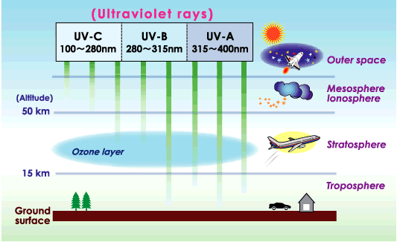
Ozone depletion http://www.theozonehole.com/

Slide 6
Ozone: natural cycle (stratosphere)
Formation of ozone:
O₂ + uv ⎯→ O• + O• (uv = 242 nm)
O₂ + O• ⎯→ O₃
Natural depletion of ozone
O₃ + uv ⎯→ O₂ + O• (uv = 290 – 320 nm)
O₃ + O• ⎯→ 2O₂
Rate of formation = equal to rate of depletion
= steady state
Both types of reactions are slow

Slide 7
Catalytic depletion CFCs
CCl₂F₂ → •CClF₂ + Cl•
•Cl + O₃ ⎯→ ClO• + O₂
ClO• + •O ⎯→ •Cl + O₂
•O + O₃ ⎯→ 2O₂
(Cl• = free radical; has unpaired electron- reactive)

Slide 8
Catalytic depletion by NO•
NO• + O₃ ⎯→ NO₂• + O₂
NO₂• + •O ⎯→ NO• + O₂
•O + O₃ ⎯→ 2O₂

Slide 9
Catalytic depletion by NO₂
NO₂• ⎯→ NO• + O
NO• + O₃ ⎯→ NO₂• + O₂
NO₂• + •O ⎯→ NO• + O₂
---------------------------------------------------
Net: •O + O₃ ⎯→ 2O₂
(NO• = free radical; has unpaired electron- reactive)

