Slide 1
Acid and bases: activity 1
In pairs/threes: on A3 paper draw concept maps or any other type of drawing showing what you remember about acids, bases and salts – you should include as many examples of substances as you can
(10 minutes – no other source!)
5 minutes: go around other groups to see what you have missed or tell them what they have missed
Make any changes/corrections/additions to your concept map or drawing.

Slide 2
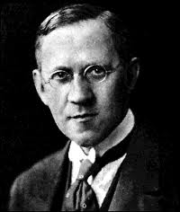
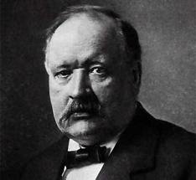
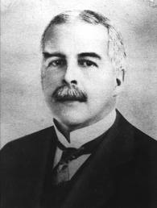
Acids and bases
Are Bronsted-Lowry acids and bases also Lewis acids and bases?
In your answer you must use 3 examples of each type of substance

Slide 3
Bronsted-Lowry and Lewis
H₂PO₄⁻ : can it have a
a conjugate base? If yes, write an equation with water as the other specie
a conjugate acid? If yes, write an equation
Use venn-diagrams to show the following relationships:
Bronsted-Lowry bases and Lewis bases
Bronsted- Lowry acid and Lewis acids

Slide 4
Acids and bases: activity 3
For each type of acid-base reactions below, write 3 balanced symbol equations and their ionic equation using a different acid for each one
Types of reactions:
acid + metal oxide
acid + metal hydroxide
acid + metal carbonate
acid + metal hydrogen carbonate

Slide 5
Acids and bases
Using HCl and CH₃COOH, as examples find the differences and similarities between strong and weak acids. You should cover pH, conductivity and reactivity
Use the following animations:
weak and strong acids and base solutions
conductivity in weak and strong acdis and alkalis
You can refer to the data collected from your investigation into weak and strong acids and alkalis
How would you determine experimentally if an acid or alkali is weak or strong? Give enough detail!!!

